Slide 1
Created by: https://www.instructables.com/member/fluxaxiom/

Slide 2
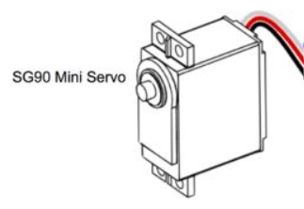
- REVISED
- REVISED
SG90 Micro Servo
SG9 Micro Servo
SG90 Micro Servo

Slide 3

- REVISED
- REVISED
SG9 Micro Servo
Top servo – pin D11
Bottom servo – pin D10
Laser – pin D2
Power
Ground
SG90 Micro Servo
Arduino Nano V3

Slide 4
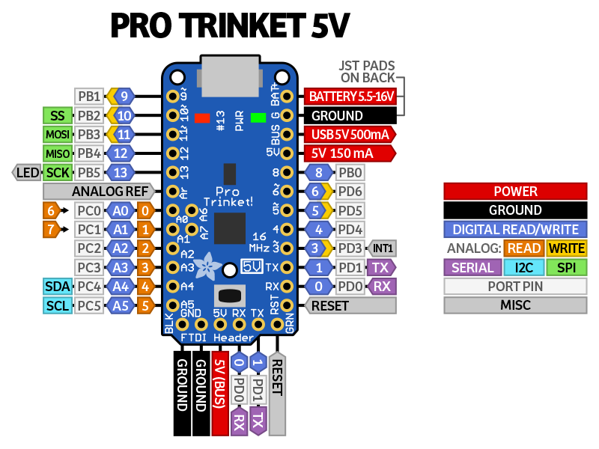
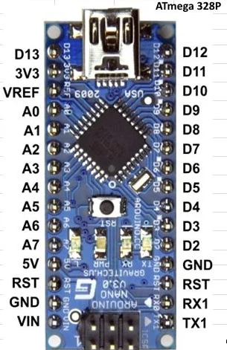
Arduino Nano V3 and Pro Trinket Pinouts
Arduino Nano V3

Slide 5
- REVISED
- REVISED
SG9 Micro Servo
Top servo – pin D11
Bottom servo – pin D10
Laser – pin D2
Power
Ground
SG90 Micro Servo
Arduino Nano V3

Slide 6
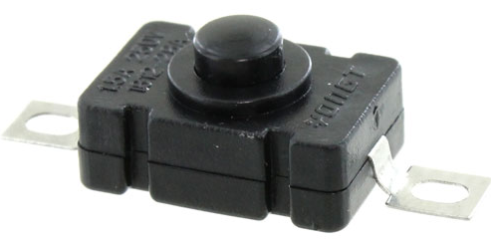
- REVISED
- REVISED
SG9 Micro Servo
Top servo – pin D11
Bottom servo – pin D10
Laser – pin D2
Power
Ground
SG90 Micro Servo
Arduino Nano V3
Micro Switch

Slide 7
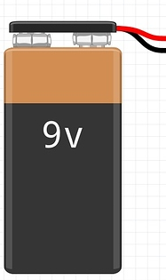
- REVISED
- REVISED
SG9 Micro Servo
Top servo – pin D11
Bottom servo – pin D10
Laser – pin D2
Power
Ground
SG90 Micro Servo
Arduino Nano V3
Micro Switch

Slide 8

Arduino Nano V3 and Pro Trinket Pinouts
Arduino Nano V3

